Slide 1
CA3 CASE STUDY · BUSINESS INTELLIGENCE
Renewable Energy Intelligence
Solar Generation, Electricity Demand and Energy Performance Analytics Using R
Ishika Ishwar Geed – 23070521060
Harshavardhan Kurri - 23070521058
B.Tech, Computer Science and Engineering
Symbiosis Institute of Technology, Nagpur
Symbiosis International (Deemed University)
Faculty Name – Dr. Snehlata Wankhade
Academic Year – 2026-27
Notes:
Good morning. I'm Ishika Ishwar Geed, and this is my CA3 Business Intelligence case study. My project is called Renewable Energy Intelligence. I built an interactive dashboard in R that looks at India's solar and wind generation against electricity demand, hour by hour. In the next few minutes I'll explain the problem, how I built the dashboard, what it shows, and what a planner could do with it.

Slide 2
Why analyse generation with demand?
Solar output follows daylight and weather, and is zero at night
Electricity demand changes by hour, day type and season
Renewable output does not always line up with demand
Planners need reliable evidence to decide on flexibility and storage
Renewable generation
solar + wind
Electricity demand
national, hourly
Energy planning
storage, ramping, forecasting
Business problem
How do solar and wind generation vary against national demand by hour, season and day type, and how much residual demand must other resources meet?
Notes:
Solar and wind are cheap and clean, but they are variable. Solar only works in daylight, and demand has its own daily and seasonal pattern. So a planner can't just look at generation, or just at demand. They have to look at both together. The question my project answers is on the bottom of the slide: how do solar and wind compare with national demand over the day and across seasons, and how much demand is left for other sources to meet. Next, I'll show the objectives and scope.

Slide 3
Objectives and scope
1
Summarise solar, wind and total renewable generation against demand
Scope
Geography: India, five regional grids combined
Dashboard coverage: Jan 2024 – Jun 2025, hourly
Screenshots shown: 25 May – 24 Jun 2025, weekends only (9 days)
Not included: weather, plant-level, installed-capacity or storage data
2
Identify hourly and seasonal patterns in solar and wind
3
Measure residual demand, hourly ramps and renewable share
4
Forecast daily demand with holdout validation
5
Deliver all of this in an interactive R Shiny dashboard
Notes:
I set five objectives. First, summarise solar, wind and total renewable generation against demand. Second, find the hourly and seasonal patterns. Third, measure residual demand, which is demand minus solar and wind, along with how fast it changes and what share renewables cover. Fourth, forecast daily demand and check it with a holdout test. And fifth, put it all in an interactive Shiny dashboard. On the right is the scope. The data is national, for all of India. The dashboard covers January 2024 to June 2025, but the screenshots I use today show one filtered window: weekends between 25 May and 24 June 2025. So my numbers describe that slice, not the whole year.

Slide 4
Dataset and data preparation
Field | Unit | Meaning
TIMESTAMP | hourly | Date and hour (IST)
DEMAND_GW | GW | National electricity demand
SOLAR_GW / WIND_GW | GW | Solar / wind generation
RENEWABLE_GW | GW | Solar + wind
RE_SHARE | % | Renewable ÷ demand × 100
NET_DEMAND_GW | GW | Demand − renewable
NET_RAMP_GW | GW/h | Hour-to-hour change in net demand
Preparation in R
Load hourly records
Parse timestamps, convert MW to GW
Derive renewable, share, residual demand, ramp
Add season and day-type labels for filters
Source: Grid-India (NERLDC), Ministry of Power. Combined five regional grids. Hourly data; dashboard coverage Jan 2024 – Jun 2025.
[Confirm: record count and cleaning steps from R script]
Dataset: Mukherjee, D., Kalita, K., & Kumar, S. (2025). Electricity demand, solar and wind generation data (September 2021–June 2025) of India at 1-hour interval (Version 2) [Data set]. Mendeley Data. https://doi.org/10.17632/y58jknpgs8.2
Notes:
The data comes from a Mendeley dataset by Mukherjee, Kalita and Kumar, based on Grid-India records. It gives national demand, solar and wind at one-hour intervals. The table lists the fields in my dashboard's Data Explorer. The first three are the raw measurements. The rest I calculate: total renewable, renewable share of demand, residual demand, and the hour-to-hour change, which I call the ramp. In R, I load the records, fix the timestamps and units, calculate these fields, and label each hour with season and weekday or weekend for the filters. I've left a placeholder for the exact record count and cleaning steps, which I will confirm from my script. The full citation is at the bottom.

Slide 5
Technology stack and methodology
1
Data acquisition
2
Data cleaning
3
Data transformation
4
KPI calculation
5
Exploratory analysis
6
Interactive dashboard
7
Business insights
Packages visible in the application
R
language
Shiny
reactive app
bslib
layout*
plotly
interactive charts
DT
interactive tables
[Confirm from code: data-manipulation, date-time and forecasting packages]
*Cards, value boxes and collapsible sidebar are consistent with bslib.
Penetration (%) = Renewable ÷ Demand × 100
Residual demand = Demand − (Solar + Wind) | Ramp = Residual(t) − Residual(t−1)
A residual-demand gap is not a supply deficit: other sources, storage and transfers balance it.
Notes:
This is the workflow, from data acquisition at the left to business insights at the right. For technology, the dashboard clearly uses R with Shiny for the interactive app, plotly for the interactive charts, and DT for the tables. The layout, with cards and a collapsible sidebar, is consistent with bslib. The yellow box is a reminder for me to confirm the other packages from my code, so I'm not claiming anything I can't show. At the bottom are the formulas. The most important idea: residual demand is demand minus solar and wind. It does not mean a blackout or shortage, because thermal, hydro, nuclear, storage and imports fill that gap.

Slide 6
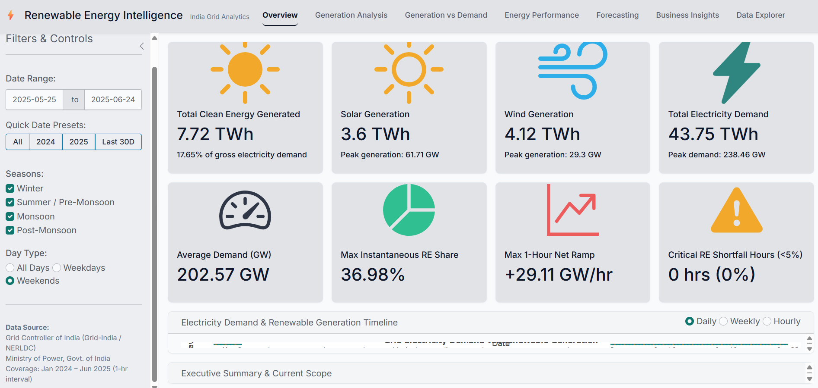
Dashboard overview
Main components
8 KPI cards: energy, demand, peak, ramp
7 navigation tabs
Sidebar filters: dates, season, day type
Interactive plotly charts
Data Explorer with CSV download
Figure 1. Renewable Energy Intelligence dashboard overview (25 May–24 Jun 2025, weekends).
Source: Author's own screenshot of the Renewable Energy Intelligence application developed using R Shiny.
One set of filters drives every tab, so a planner can move from headline KPIs to distributions and raw records for the same period.
Notes:
This is the Overview tab. At the top are eight KPI cards: total clean energy, solar, wind, total demand, average demand, the highest renewable share, the biggest one-hour ramp, and how many hours renewables supplied less than five percent. On the left is the filter panel: a date range, quick presets, season checkboxes and weekday or weekend. These filters apply across the tabs. The top bar has seven tabs, from Overview to Data Explorer, where users can search the hourly records and download the filtered data as a CSV. All numbers on the next slides come from this filtered view: weekends from 25 May to 24 June 2025.

Slide 7
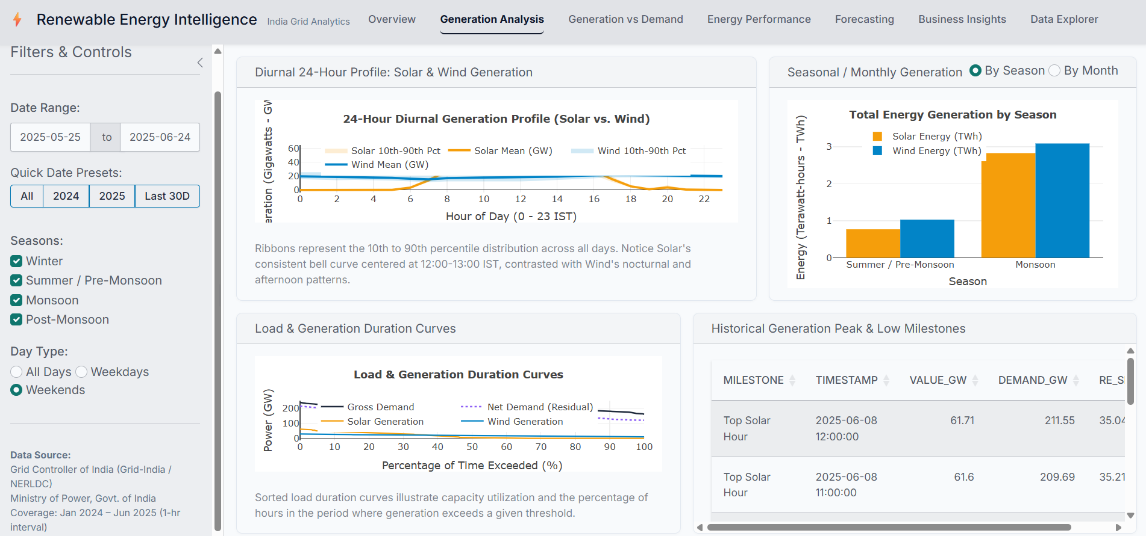
Solar and wind through the day and season
What the data shows
Solar forms a bell curve around 12:00–13:00 IST and is near zero overnight
Wind is present through the day, covering night hours
Top solar hour: 8 Jun, 12:00 at 61.71 GW, with demand at 211.55 GW
Solar alone then covered about 29% of demand (derived)
Figure 2. Generation Analysis: diurnal solar and wind profile, seasonal totals and peak milestones.
Source: Author's own project screenshot.
Read with care: seasonal bars are summed totals, and the window has 2 May and 7 June weekend days, so they do not show seasonal intensity.
Notes:
This is the Generation Analysis tab. The top-left chart shows the average solar and wind output for each hour of the day. Solar looks like a bell: nothing at night, a peak around noon to one o'clock. Wind is there all day, so it helps cover the night. The strongest solar hour in my window was 8 June at 12:00, at 61.71 gigawatts, when demand was 211.55. Dividing the two, solar alone supplied about 29 percent, which is my own calculation. One caution: the seasonal bar chart adds up energy, and this window has only two weekend days in May but seven in June. So the June bars are taller mainly because there are more days, not because June is stronger. Next, the main findings.

Slide 8
Key findings (descriptive)
17.65%
Solar + wind share of demand
61.71 GW
Peak solar, near zero overnight
Shows: 7.72 of 43.75 TWh; highest hour 36.98%; no hour below 5%.
Matters: Over 82% still came from other sources, so plan around residual demand.
Shows: Solar is concentrated in daylight hours.
Matters: Evening and night supply relies on wind and non-solar resources.
+29.11 GW/h
Largest one-hour rise in residual demand
6.16%
Holdout MAPE, daily demand forecast
Shows: Hourly ramp distribution has a right tail up to about +30 GW.
Matters: Dispatchable sources and storage need ramping flexibility.
Shows: 14-day horizon, 0.15 holdout; RMSE 15.53 GW.
Matters: Indicative only: no benchmark forecast is reported.
Descriptive results for 25 May – 24 Jun 2025, weekends only (9 days). No causal claims; “clean” means solar + wind only.
Notes:
Four findings. One: solar and wind together supplied 17.65 percent of demand, and wind supplied slightly more energy than solar. The most they reached in one hour was about 37 percent, and never below 5 percent. So more than 82 percent came from other sources. Two: solar peaked at 61.71 gigawatts but is near zero overnight. Three: residual demand rose by up to 29.11 gigawatts in a single hour. That is what flexible power plants and storage need to handle. Four: my demand forecast had a holdout error of 6.16 percent on average, but I haven't compared it to a simple baseline, so I treat it as indicative. All of these are descriptive results for nine weekend days. They show patterns, not causes.

Slide 9
Recommendations (proposals only)
Evaluate storage that shifts midday solar into the evening
Evidence: solar near zero after sunset; ramps up to +29.11 GW/h
Needs: dispatch modelling, curtailment and cost data
1
Plan ramping capability for the evening window
Evidence: right tail of the hourly ramp distribution
Needs: unit-level ramp limits, sub-hourly data
2
Explore time-of-day load shifting
Evidence: solar output concentrated around midday
Needs: flexible-load shares and tariff data
3
Strengthen forecasting and data
Evidence: 6.16% MAPE with no baseline for comparison
Needs: baseline, weather, plant-level data
4
None of these has been implemented or tested; each needs validation with additional data.
Notes:
These recommendations come straight from the findings, and I want to be clear they are proposals, not results. One: evaluate storage that moves midday solar into the evening, because solar vanishes at sunset and residual demand ramps up. To size it properly you would need dispatch modelling and cost data. Two: plan ramping capability for the evening window. Three: explore time-of-day load shifting, since solar is concentrated around midday. This needs data on how much load is flexible and on actual tariffs. Four: strengthen forecasting, adding weather and plant-level data and comparing against a simple baseline. I haven't measured any savings or efficiency gains, so I'm not claiming any.

Slide 10
Limitations and future scope
Limitations
Future scope
Screenshots cover only 9 weekend days
National hourly totals hide regional and sub-hourly ramps
No weather, irradiance, capacity or plant data, so losses and efficiency cannot be measured
Residual demand is not a supply deficit
Forecast: one holdout, no benchmark
Add weather and irradiance variables
Use regional and plant-level data
Simulate battery dispatch
Forecast solar and wind with baselines
Check that Business Insights text is computed from the filtered data
Notes:
Now the limitations. My screenshots cover only nine weekend days, so I can't generalise to the whole year. The data is national and hourly, so it hides regional differences and faster changes within the hour. I don't have weather, irradiance, capacity or plant data, so I cannot measure solar panel losses or efficiency, and I don't claim to. Also, residual demand isn't a shortage. And my forecast used one holdout test and no baseline. For future work, I would add weather data, regional and plant-level data, simulate battery dispatch, forecast solar and wind, and check that the text in my Business Insights tab updates with the filters.

Slide 11
Conclusion
Problem
Solar and wind vary; planners need to see them against demand
Solution
An interactive R Shiny dashboard on hourly Grid-India data
Findings
17.65% renewable share; peak solar 61.71 GW; ramps up to +29.11 GW/h
Value
Shared filters link KPIs, distributions, a forecast and raw data
Contribution
A transparent view of residual demand that avoids calling it a deficit
Descriptive evidence that shows planners where to look next: evening ramps, storage and better forecasting.
Notes:
To conclude. The problem was that planners need to see variable solar and wind against demand. My solution is an R Shiny dashboard built on hourly national data from Grid-India. In the window I analysed, renewables supplied 17.65 percent of demand, solar peaked at 61.71 gigawatts, and residual demand rose by up to 29.11 gigawatts in an hour. The dashboard connects KPIs, distributions, a forecast and the raw data under shared filters, and it is careful not to call residual demand a deficit. My closing message: this is descriptive evidence that points planners to the right questions, evening ramps, storage and better forecasting, and the next step is to repeat it on the full dataset with weather data.

Slide 12
References
Mukherjee, D., Kalita, K., & Kumar, S. (2025). Electricity demand, solar and wind generation data (September 2021–June 2025) of India at 1-hour interval (Version 2) [Data set]. Mendeley Data. https://doi.org/10.17632/y58jknpgs8.2
Posit Software, PBC. (n.d.). Shiny: Web application framework for R. https://shiny.posit.co/
R Core Team. (n.d.). R: A language and environment for statistical computing. https://www.R-project.org/
Sievert, C., Cheng, J., & Aden-Buie, G. (n.d.). bslib [R package]. https://doi.org/10.32614/CRAN.package.bslib
Sievert, C., Parmer, C., Hocking, T., et al. (n.d.). plotly [R package]. https://doi.org/10.32614/CRAN.package.plotly
Xie, Y., Cheng, J., Tan, X., & Aden-Buie, G. (n.d.). DT [R package]. https://doi.org/10.32614/CRAN.package.DT
Thank You
Questions?
Notes:
These are my main sources: the Mendeley dataset, and the official documentation for R, Shiny, bslib, plotly and DT. Screenshots in this presentation are from my own application. Thank you for listening. I'm happy to take questions. If I'm asked about something I haven't verified, such as the exact forecasting model or cleaning steps, I will check my R script rather than guess.

